Slide 1
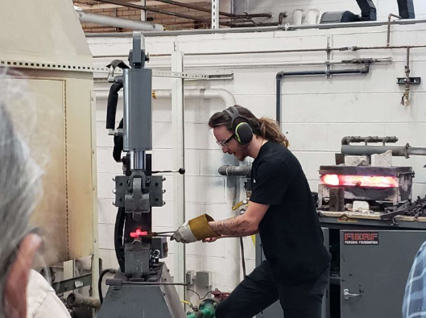
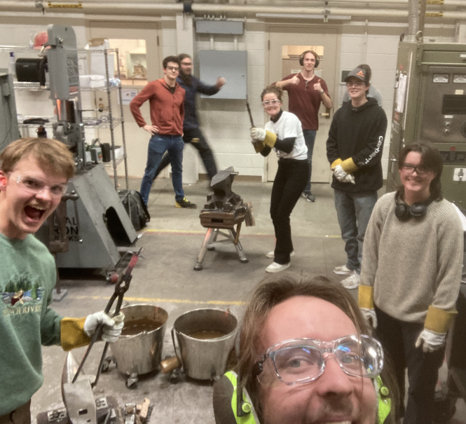
How To Start: FORGING CLUB
Mason Weems
Colorado School of Mines
mbweems@mines.edu

Slide 2
Summary
Introduction
How to start a club
Safety
Buying equipment
Classes
How to maintain a club
Building equipment
Gaining engagement
Competitions and local interaction

Slide 3
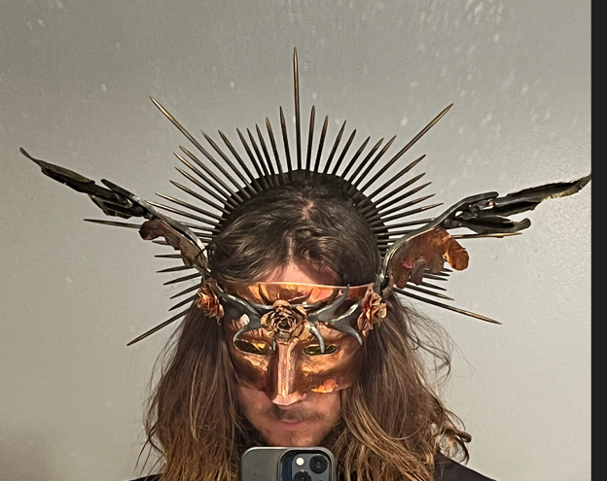
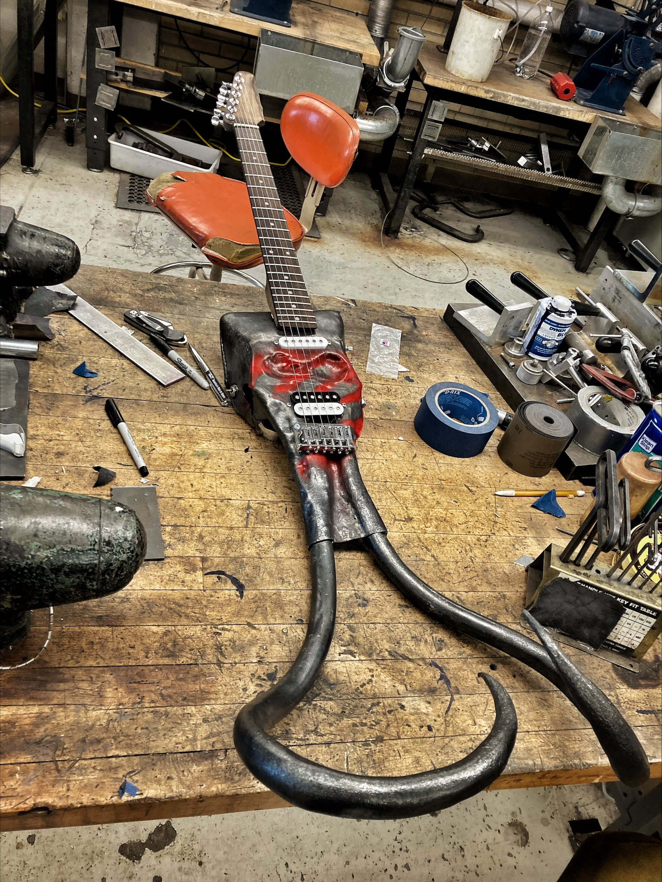
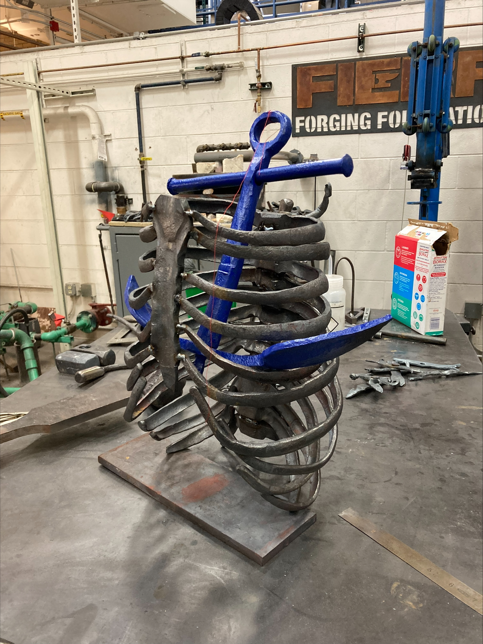
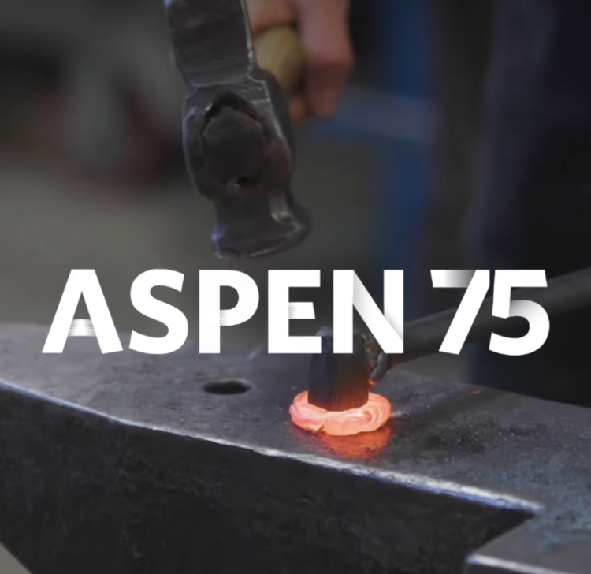
Colorado School of Mines
Started forge in 2017
I got there (undergrad) in 2019
Took over in 2020
Built up/refined classes and open shop over the last 4 years
Still there for PhD (second year)
Participated in FIERF comp both 2023/2024

Slide 4
Where are you all at?
How to Start:
Who is the building manager?
Who is in charge of the space/scheduling?
Where is the lab, and how can you work with nearby labs?
Can they help support (welding?)
What other local equipment do you need to be aware of?
Is there sensitive equipment nearby (no power hammers)
Where is the funding coming from?
FIERF/School club funding/professor support?
Is EHS on board with what you’re doing?
What safety considerations do you need?
School considerations:
Club requires:
Professor advisor
10 interested students
Bylaws
Lab space requires:
Safety considerations
Funding sources
Maintenance

Slide 5
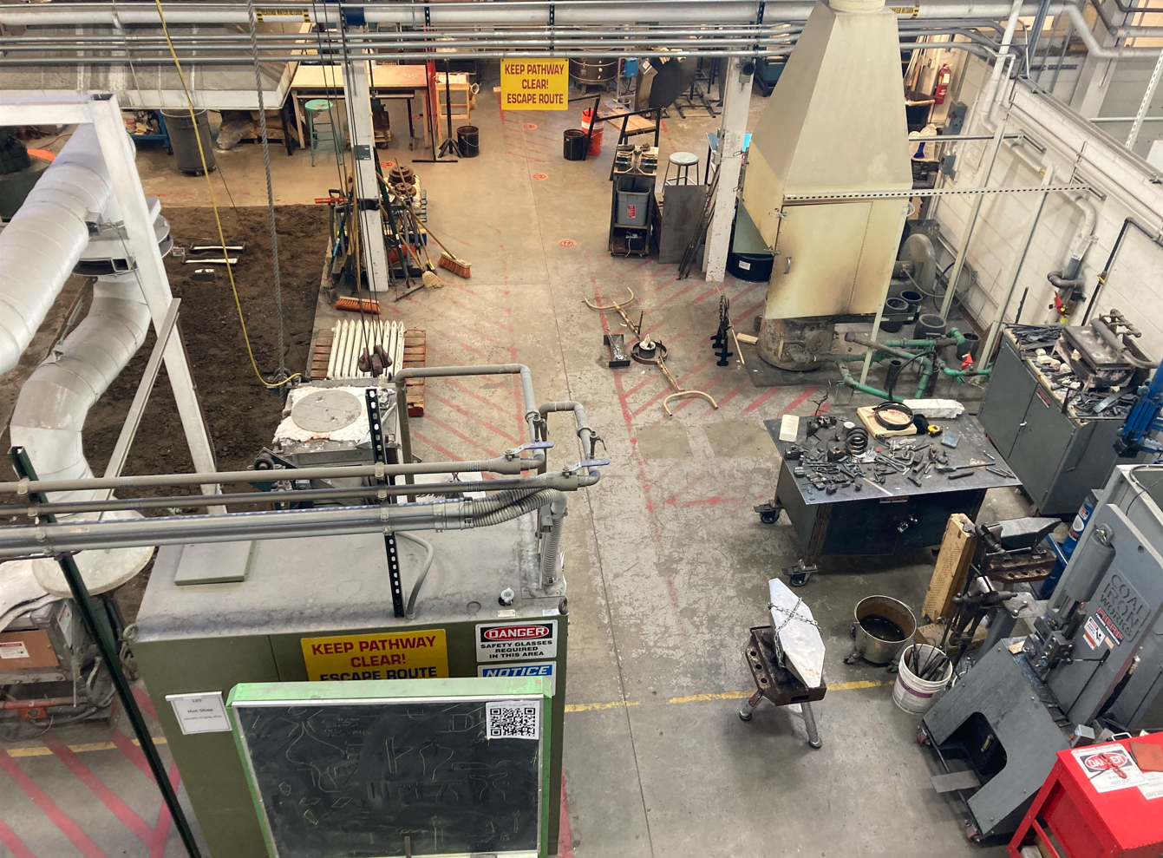
Glassblowing
Foundry
Forge
Welding & Grinding
Nano-indenters, atom probes, etc
Storage

Slide 6
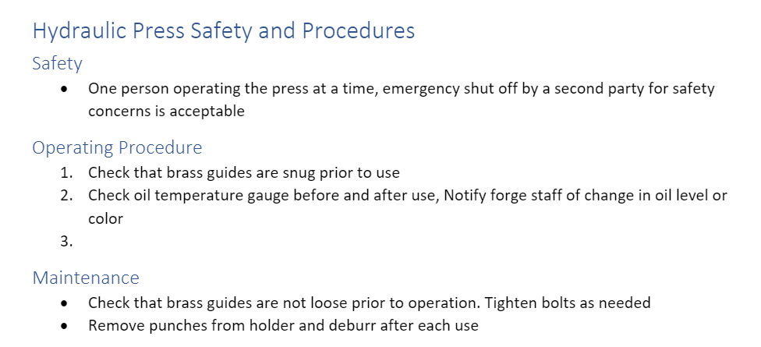
Safety First! Coordinating with Environmental Health and Safety
What equipment is most dangerous? Write safety procedures
How do you dispose of scrap? Metal recycling vs dumping
Ventilation? Hoods over the furnace
PPE
Safety Glasses
Long Pants
Closed-Toe Shoes
Hair Tied Back
No Jewelry
Gloves
Long Sleeves
Hearing Protection

Slide 7
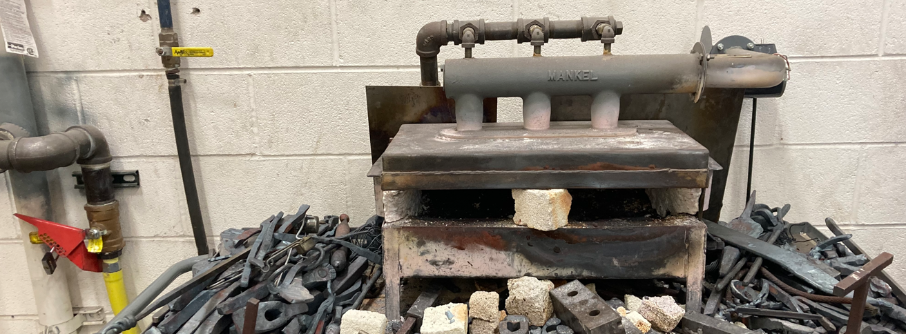
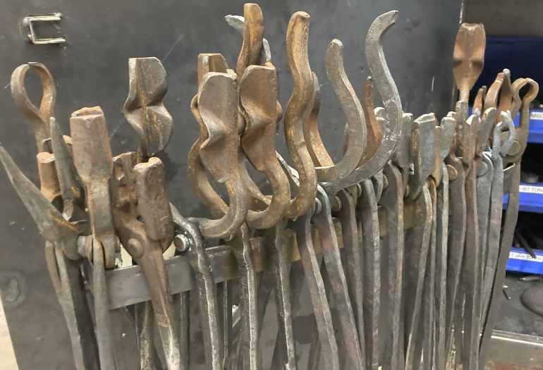
What needs to be locked up?
Ignition Sources
Heavy Machinery
Tools
Anvils?
Who gets keys?
Head Smith(s) (students)
Funding Prof
Building/Lab Manager

Slide 8
Starting equipment: What to buy?
What equipment do you start with?
Forge
Propane? Coal? Induction?
Anvils
How big? How many?
Hammers
Tongs
Heavy Machinery
Press?
Power Hammer?
Treadle Hammer?
Stock
1060 large bar: Dies, hardie tools, punches
1045 large bar: Hammers, top tools
1018 various sizes: Tongs, hooks, etc
What can you make once you have stuff started?
Tongs
ALWAYS need more tongs- great practice, great tools!
Hammers
The heaviest you can CONTROL
Rounding, cross peen, straight peen, etc
Hardie tools
Hot cuts, fullers, round swages, cone mandrels, turning forks, making rivets
Top tools
Cutting, fullering, flattening
Punches/Chisels
Tong boss punches, hammer eye punches, chisels and fullers for texture
Dies
More complicated- understand your machinery!

Slide 9
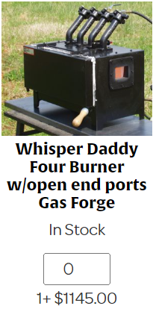
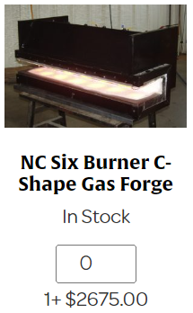
Personal Recommendations
Forge: 100-lb Propane Tanks
NC Tool Shop: Large Blacksmith Forges (nctoolco.com)
Press Or Power Hammer:
Presses are quieter, slower, easier to control, easier to modify, a bit safer
https://coaliron.com/products/25-ton-forging-press
MZ75 power hammer
Tongs, Hammers, Anvils:
Oleo Acres (oleoacresfarriersupply.com)
Tongs: Wolf-Jaw or V-Bit
Should fit ¼” stock up to ¾” stock (for making more tongs!)
Hammers: Cross-Peen vs Rounding
Lighter than you think: 2-3lb max, except for sledges
Anvils:
Talk to local smiths! Harbor Freight is fine to start…

Slide 10
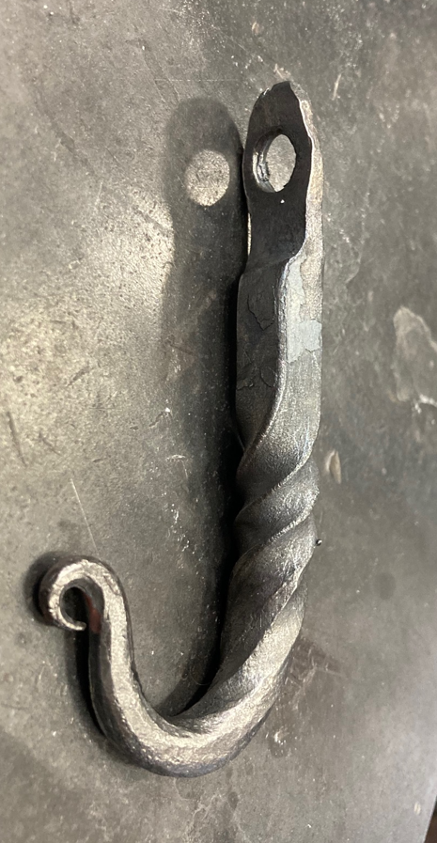
Intro Classes
Punched Hole
Shoulder
Class 1: Keychain
Safety in the shop, hammer technique
Class 2: Bottle Opener Part 1
How to make 3 types of clean tapers
Class 3: Bottle Opener Part 2
How to bend in 3 ways
Class 4: Leaf Part 1
How to shoulder and cut
Class 5: Leaf Part 2
Using punches, chisels and fullers
Test: Coat Hook
Put together all those skills!
Twist
Bend + Re-Bend
Round Taper

Slide 11
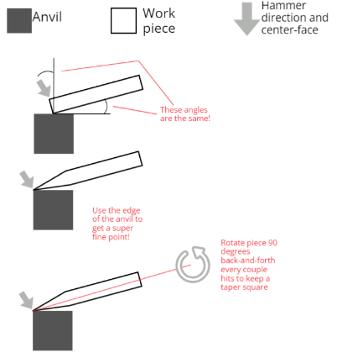
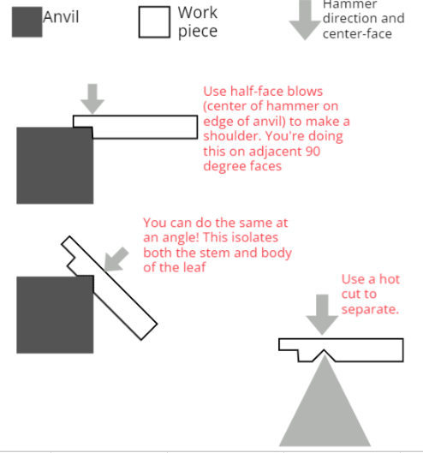
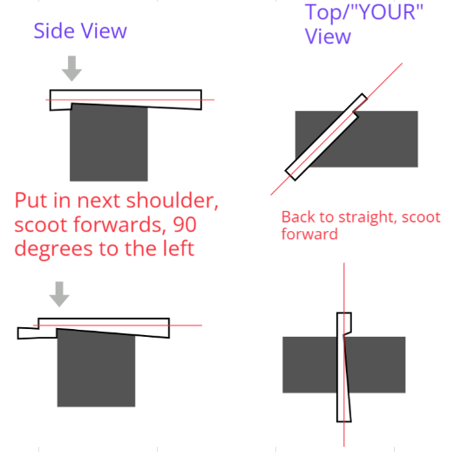
Teaching Basics and Safety
The way I do classes:
https://docs.google.com/spreadsheets/d/1-aXsPsl5QqetZUDNI0_lL9spA8yFOqgTe-PR4YBc9Y8/edit#gid=1997599597

Slide 12
How to Maintain: Building Equipment
Pliers
How to make tongs without using a lot of material
Tongs
Use the press to draw down the reins, do the rest by hand
Help build your shop with different types!
Hammer
Use almost entirely JUST the press for this
Builds the shop!
ABANA forging Curriculum
https://abana.org/education/abana-curriculum/
https://abana.org/education/controlled-hand-forging/
Rocky Mountain Smiths (Colorado’s Blacksmith Club)
https://rockymountainsmiths.org/
https://www.youtube.com/channel/UCwQzavb0mm11G3To002BOsw
Video Sources
General
https://www.youtube.com/channel/UCQXBXA3pXM5A-skemMLMrug
https://www.youtube.com/channel/UCdOM6Qc53TcWuExrnDLVjXg
https://www.youtube.com/channel/UCSFaYYQzNMLo2U6rSNLpghg
Good for tongs and tools:
https://www.youtube.com/channel/UCZ3rO8Nb9I1p9Wh_lQ6ebew
https://www.youtube.com/user/MarkAspery
https://www.youtube.com/channel/UCmJ3R3FIdB247BBCNWqVkPQ

Slide 13
Reaching Student Audiences Connecting with Classes, Clubs, Comps, Locals, and Research
What classes can you crossover with on campus?
Welding, Forging & Forming, Bladesmithing
What clubs can you interact with?
Materials Advantage chapters, art clubs
What competitions can you participate in?
FIERF!!
What local groups can you get in contact with?
Rocky Mountain Smiths, Upper Midwest Blacksmith Association, ABANA
How can the forge support other campus activities (research)?
Sample prep, testing, etc

Slide 14
Open Shop Encouraging Creativity and Exploration
No Knives!
Ok, maybe SOME knives, but restrict knifemaking!
Nothing impedes building blacksmithing skill like knifemaking
Social Media!
Encourage students to gain inspiration from other blacksmiths
Build support and engagement in your club by posting projects
Art Clubs!
Tie-in with local art clubs to build inspiration and engagement

Slide 15
Any Questions?
And thanks for listening!
Mason Weems
mbweems@mines.edu

